Slide 1



A study of morphometric patterns of brain development in premature infants
PROJECT 11, CNN Master
Marion Pavaux
Supervised by Andrea Gondova & Jessica Dubois
inDev Team, Inserm NeuroDiderot UMR1141 department. CEA Saclay, NeuroSpin center
Notes:
Collab with inDev team at the Neurospin center

Slide 2
INTRODUCTION
Notes:
Introduce issues linked to brain development

Slide 3
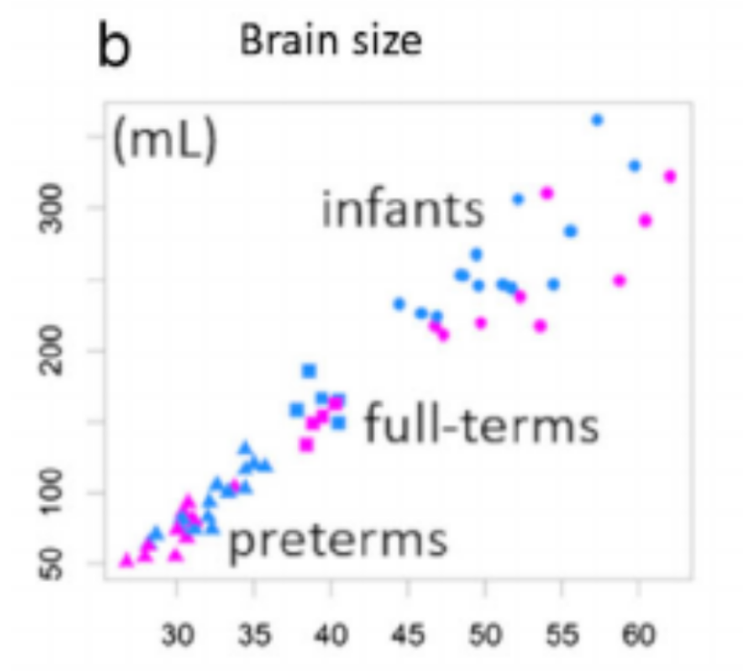
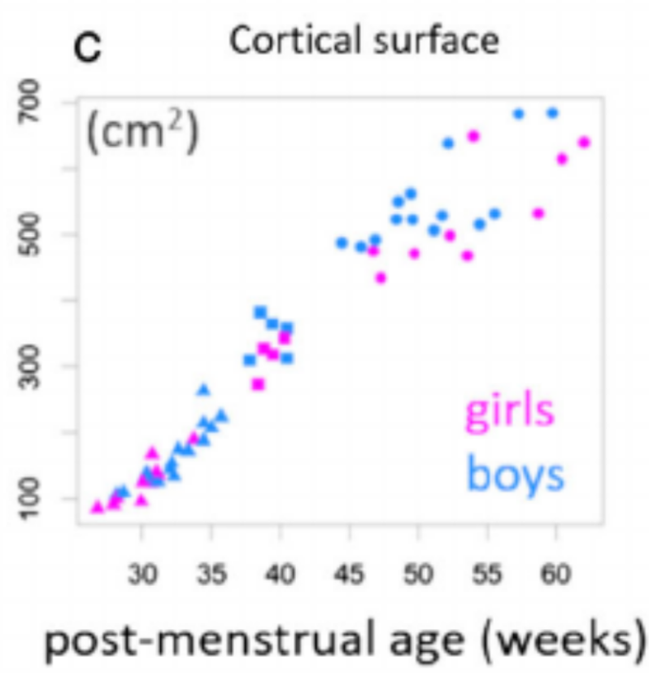
Introduction – Brain development in infants
[1] Jessica Dubois et al., 2020, Journal of Magnetic Resonance Imaging
Notes:
Brain development
Size of the brain too
Cortical surface

Slide 4
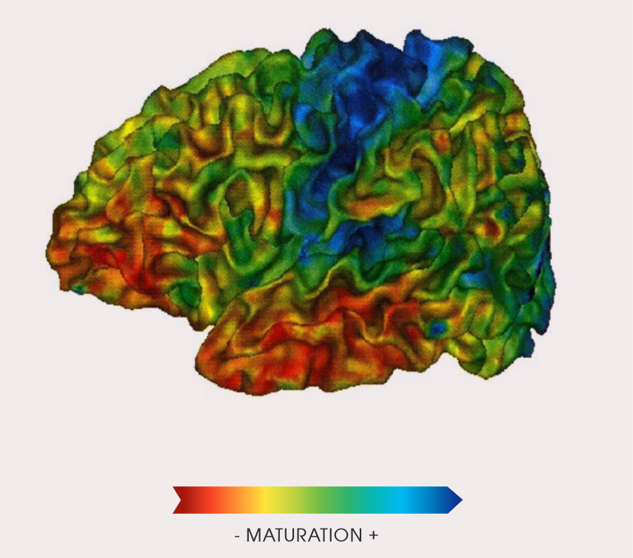
Introduction – Brain development in infants
[1] Jessica Dubois et al., 2020, Journal of Magnetic Resonance Imaging
Notes:
Maturity

Slide 5
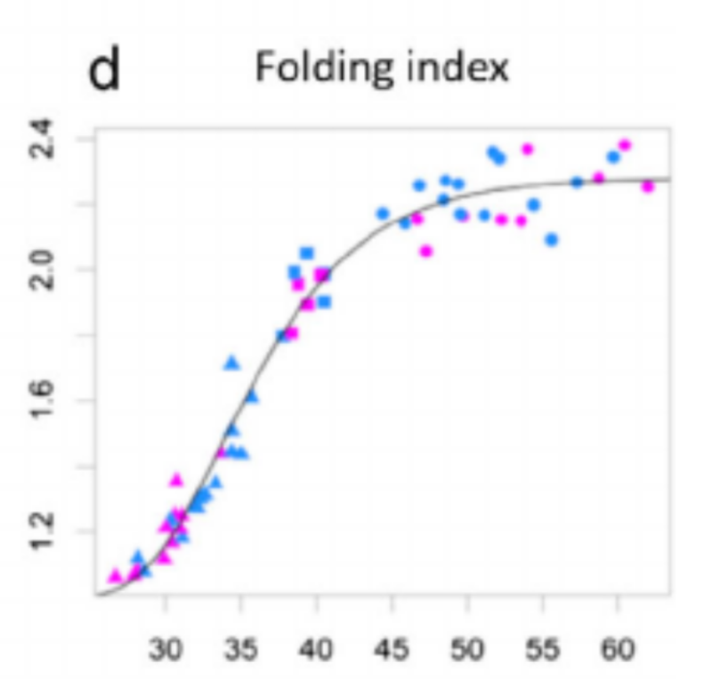
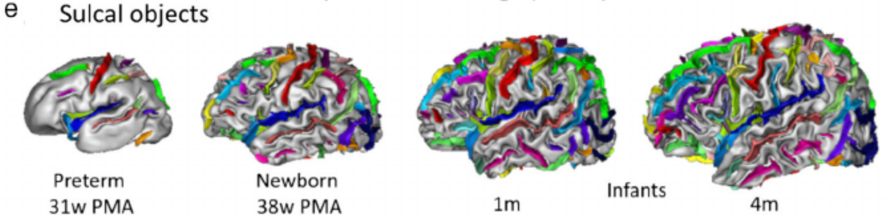
Introduction – Brain development in infants
[1] Jessica Dubois et al., 2020, Journal of Magnetic Resonance Imaging
Notes:
Cortical folding
1. early development - complex and fast changing –
Preterm birth has been shown to have a long-term effect on brain development
We want to use preterm infants to understand it and to build new remediation strategies
Preterm infant : birth before 37 weeks of gestation

Slide 6
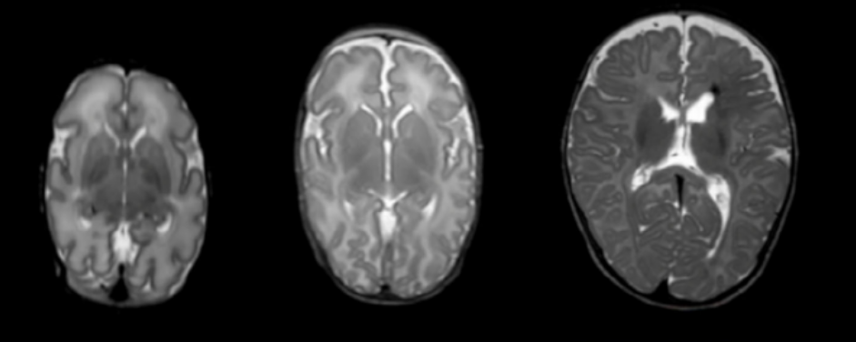
Introduction – Studies on pre-term infants
ANATOMICAL MRI
Brain anatomy
[1] Jessica Dubois et al., 2020, Journal of Magnetic Resonance Imaging
Notes:
Study prematurity with MRI
Anatomy

Slide 7
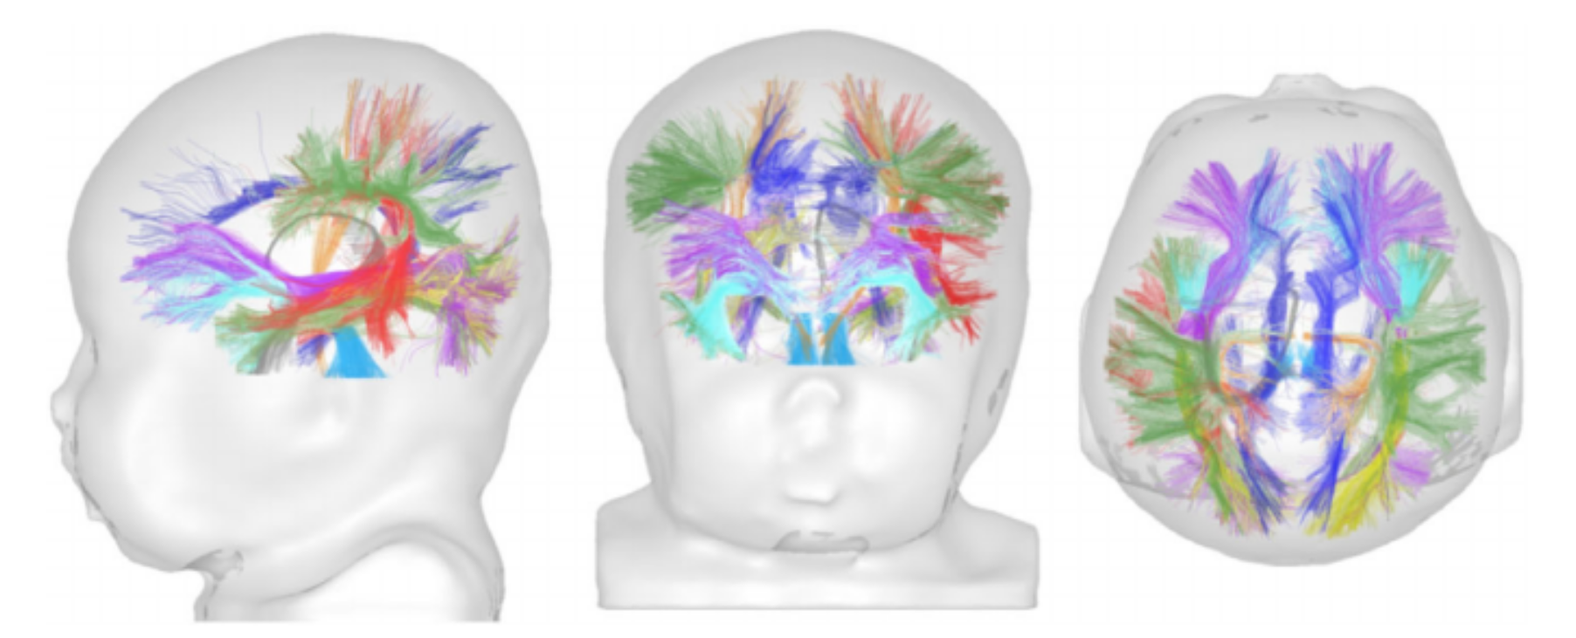
Introduction – Studies on pre-term infants
ANATOMICAL MRI
STRUCTURAL MRI
Brain anatomy
White matter bundles trajectory
[1] Jessica Dubois et al., 2020, Journal of Magnetic Resonance Imaging
Notes:
Structural MRI
white matter bundles trajectory
From which deduce connectivity between brain regions

Slide 8
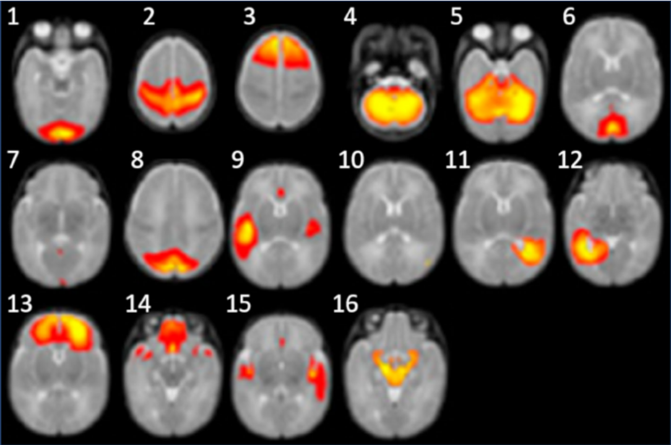
Introduction – Studies on pre-term infants
ANATOMICAL MRI
STRUCTURAL MRI
FUNCTIONAL MRI
Brain anatomy
White matter bundles trajectory
Resting state
[1] Jessica Dubois et al., 2020, Journal of Magnetic Resonance Imaging
Notes:
Functional MRI
Task-based or resting state measure of activity in different brain regions
Connectivity, functional studies → need to parcellate the brain into regions of interest

Slide 9
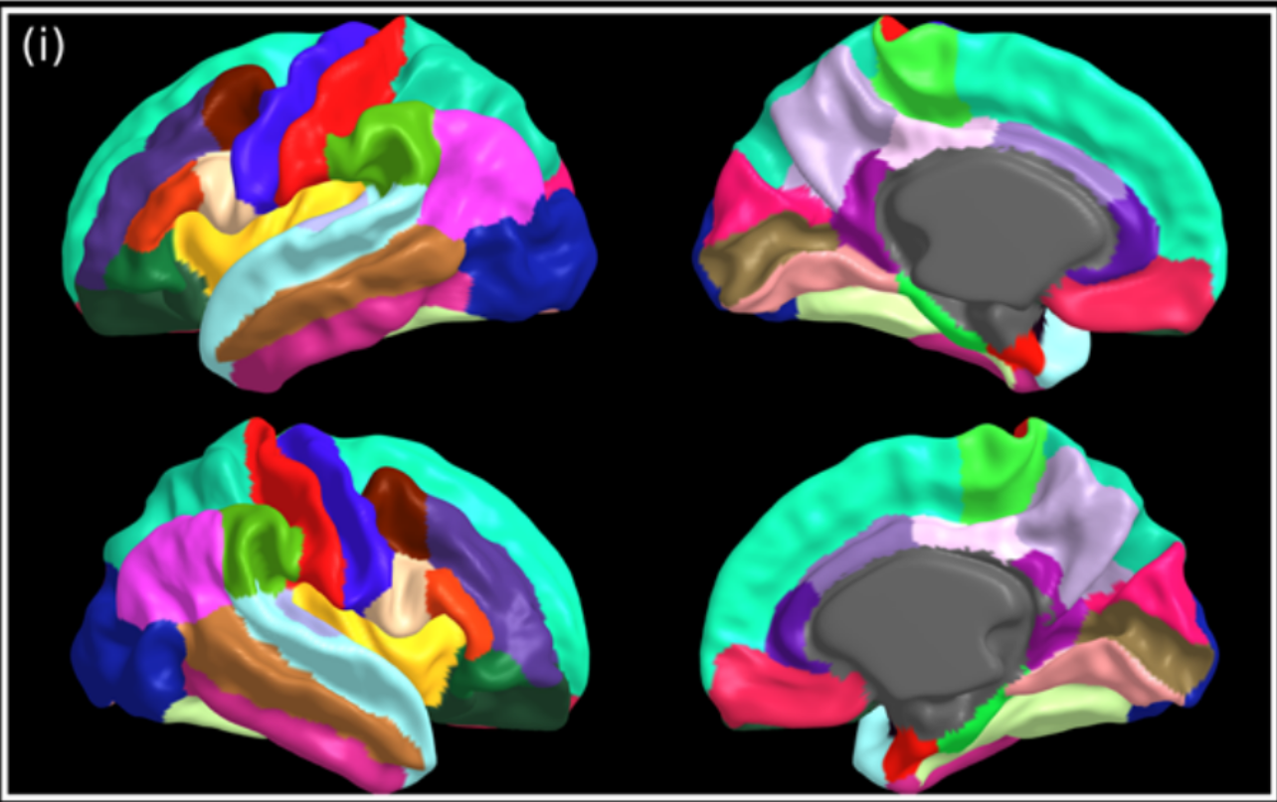
Introduction – Brain parcellation
MCRIB-S DKT
[2] Chirs.L Adamson et al., 2020, Nature|Scientific reports
Notes:
Parcellation example
Many schemes here MCRIB-S DKT for 40 weeks brains
Scheme work for 40 weeks, let’s say from 38 to 43 but not on younger brains.
Study DEVELOPING BRAINS need different ages parcellation
Preterm younger

Slide 10
Introduction – Problematic
Find an efficient parcellation scheme for pre-term infants brains
Notes:
Idea: match a younger brain to an older one, apply the parcellation of the older one to the younger one
Matching is called REGISTRATION

Slide 11
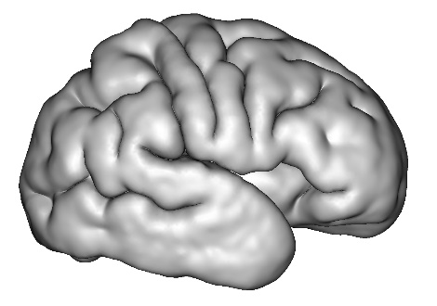
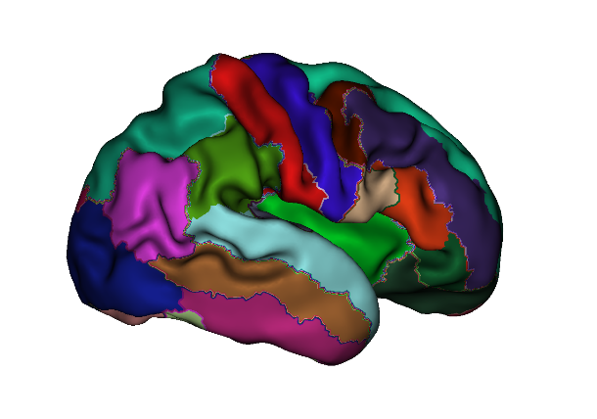
Introduction – Registration
REGISTRATION
40 weeks template
PARCELLATION
Notes:
Surface represented by a mesh
Regisgter mesh to a template
+ easy, same age template
- All brains different, variability between individuals

Slide 12
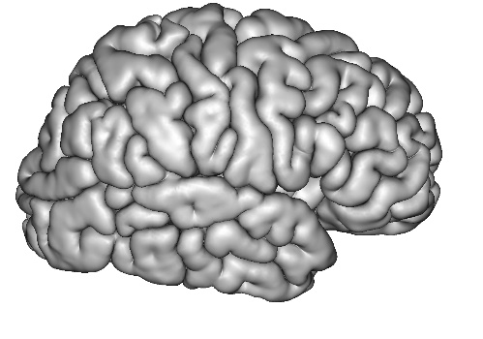
Introduction – Registration
REGISTRATION
40 weeks template
= same brain
but older
PARCELLATION
Notes:
Registration mesh through same individual but later scan
+ variability between individuals
Project: test which way is the best, can we obtain good results

Slide 13
METHOD
Notes:
Let me describe the method we used to answer this question

Slide 14
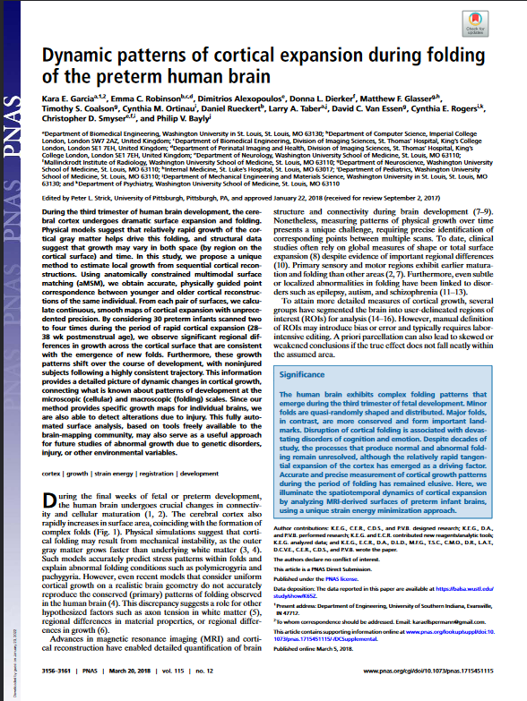
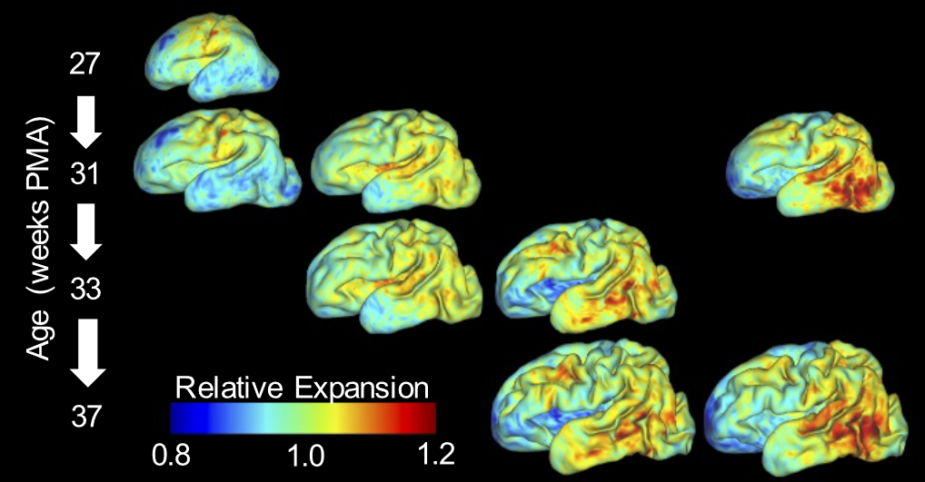
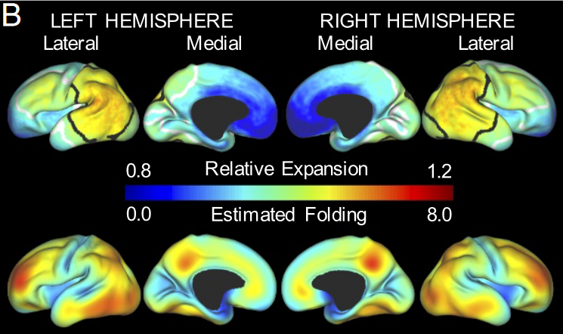
Discussion
[6] Kara E. Garcia et al., 2018, Proceedings of the National Academy of Sciences
Notes:
We based our work on this article
Show that cortical expansion linked with émergence of new folds
Registration tool MSM (Multimodal surface matching)
We tried the same configuration

Slide 15
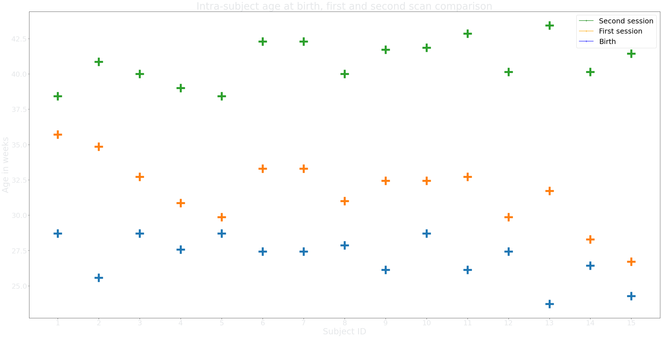
Method – Data
dHCP database
32 channel head coil 3 Tesla
[3] Emer J. Hughes et al., 2017, Magnetic Resonance in Medicine
Inner surface extraction
[4] Antonios Makropoulos et al., 2018, NeuroImage
Parcellation with M-CRIB-S tool
[2] Chirs.L Adamson et al., 2020, Nature|Scientific reports
AGE (weeks) | MEAN | VARIANCE | MIN VALUE | MAX VALUE
BIRTH | 26.99 | 1.54 | 23.71 | 28.71
FIRST SCAN | 31.71 | 2.29 | 26.71 | 35.71
SECOND SCAN | 40.86 | 1.52 | 38.43 | 43.43
Table 1 Metadata for age at birth, first scan and second scan
Notes:
Our data
dHCP longitudinal data → 2 scans, one preterm, second, normal age at birth
Graphic individual, age for birth, first, second → variability 9 weeks diff between first and second scan
Surface extracted for both
Parcellation in 32 regions of interest using MCRIB S for second session

Slide 16
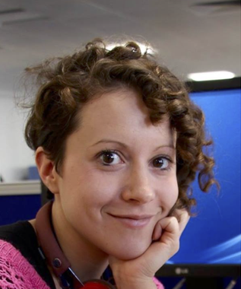
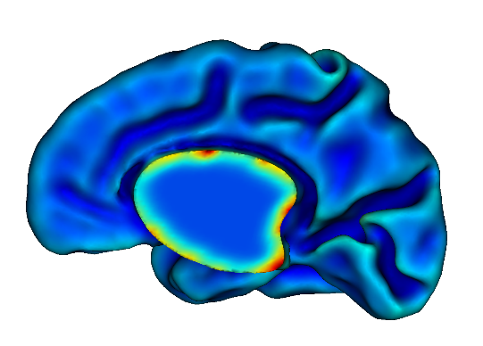
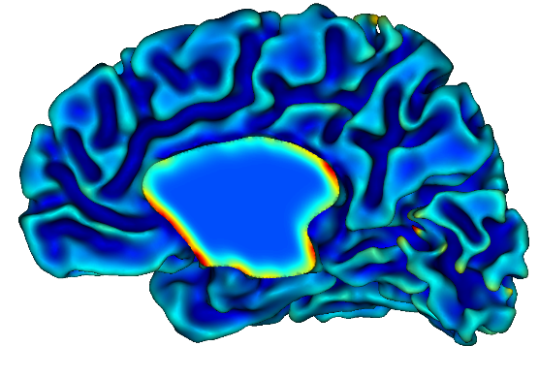
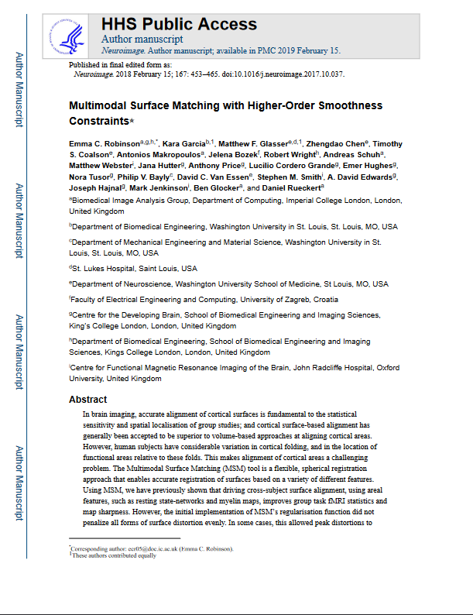
Method – MSM
SESSION 1
33.29 weeks
SESSION 2
44.86 weeks
Anatomical
CURVATURE + INNER mesh
[5] Emma C. Robinson et al., 2019, Neuroimage
Notes:
Registration tool MSM Take two meshes, inner surfaces
Meshes associated with a data = property of space like curvature
Registration will be based on this property
Any kind of data

Slide 17
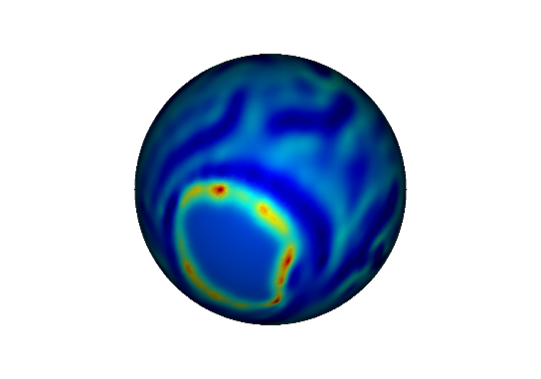
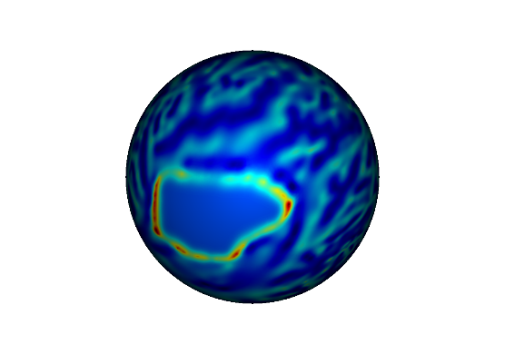
Method – MSM
SESSION 1
33.29 weeks
SESSION 2
44.86 weeks
Anatomical
Spherical
CURVATURE + INNER mesh
[5] Emma C. Robinson et al., 2019, Neuroimage
Notes:
Meshes → spheres

Slide 18
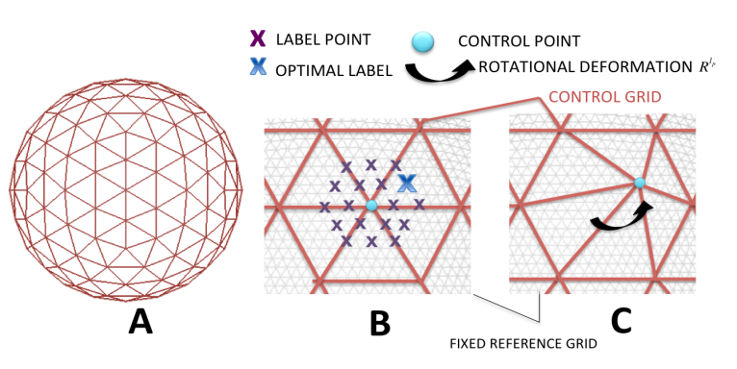
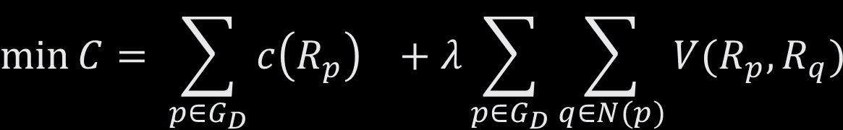
Method – MSM
$$\min{C= \sum_{p∈G_{D}}{c\left(R_{p}\right) +λ\sum_{p∈G_{D}}{\sum_{q∈N(p)}{V(R_{p}, R_{q})}}}}$$
[5] Emma C. Robinson et al., 2019, Neuroimage
Notes:
A inflated sphere
B discrete locations in second sesssion mesh toward which a control point of our first session mesh can move
Movment is a rotation
C best rotation is the one that minimizes the cost function C
Equation
First term is sum of cost of rotations for each point in grid
Second term is a penalization term, penalizes similarity for each rotation of a point of the grid with its neighbors
Output : first session mesh registered to the second session
See to apply a second session sized parcellation → need to resample it to a first session sized parcellation

Slide 19
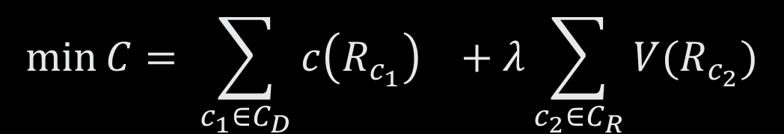
Method – sMSM
$$\min{C= \sum_{c_{1}∈C_{D}}{c\left(R_{c_{1}}\right) +λ\sum_{c_{2}∈C_{R}}{V(R_{c_{2}})}}}$$
[5] Emma C. Robinson et al., 2019, Neuroimage
Notes:
In addition to this STRAIN MSM uses instead cliques so triangles not pairs (sMSM)
Derives from strain energy, biomechanical models of tissue deformation
More realistic
First term: similarity of the clique
Second term: smoothness penalty of the regularization clique

Slide 20
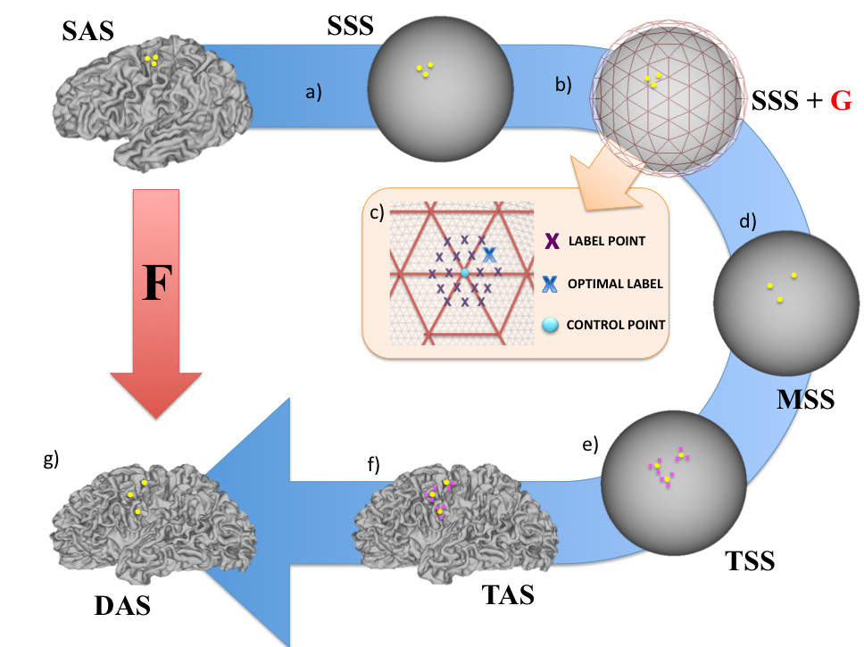
Method – aMSM
[5] Emma C. Robinson et al., 2019, Neuroimage
Notes:
Improvment
aMSM which penalizes anatomical déformations
Takes also anatomical surfaces

Slide 21
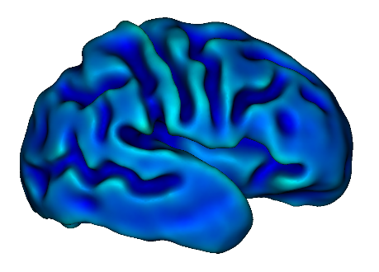
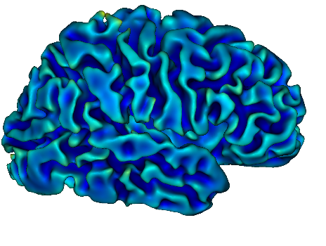
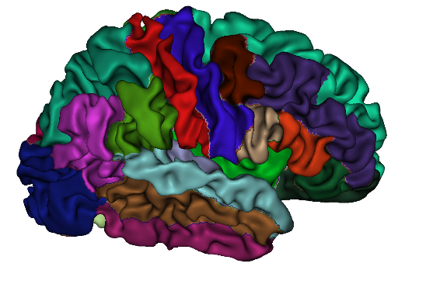
Method – MSM pipeline
REGISTRATION
INFORMATIVE REGISTRATION
PARCELLATION THROUGH
LABEL RESAMPLING
Notes:
Summarize pipeline for intra-subject matching
Same indidual

Slide 22
Method – tMSM pipeline
Rotational transform between MNI and HCP FS_LR space
ROTATIONAL TRANSFORM
40 weeks template
REGISTRATION
INFORMATIVE REGISTRATION
SURFACE RESAMPLING + PARCELLATION THROUGH
MCRIB-S
Notes:
Rotation between first session and template space
Template method uses also MSM to register but this time from first session to template space
Resampling again
Compare default MSM, sMSM, aMSM, MSM through template instead of second session
Pass our pacellations through a common space
If registration performed well, we should get no difference in size/location of regions for individuals
Compute difference between two subjects parcellations to get registration error

Slide 23
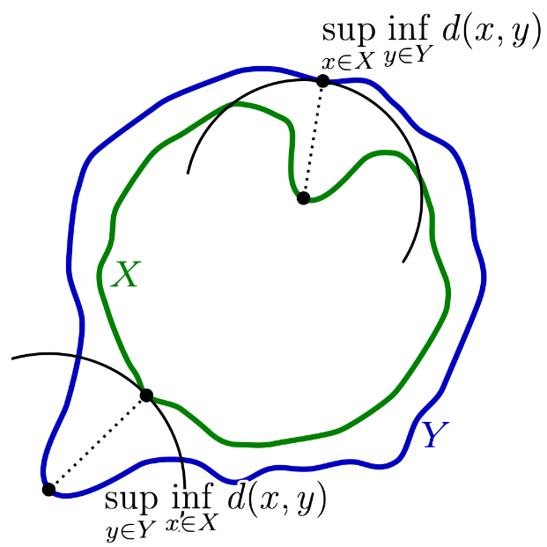

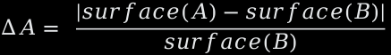
Method – Metrics
SORENSEN-DICE SCORE
HAUSDORFF DISTANCE
PERCENT AREA CHANGE
$$Dice_score= \frac{2| A∩B|}{|A|+|B|}$$
$$∆A= \frac{|surface\left(A\right)−surface\left(B\right)|}{surface(B)}$$
$$h\left(X,Y\right)=max⁡($$
$$sup_{x∈X }{\inf_{y∈Y}{d\left(x,y\right),\sup_{y∈Y}{\inf_{x∈X}{d(x,y))}}}}$$
Notes:
Dice score: similarity
Hausdorff: maximum non overlapping region
Area change
More about shape, location, size

Slide 24
RESULTS

Slide 25


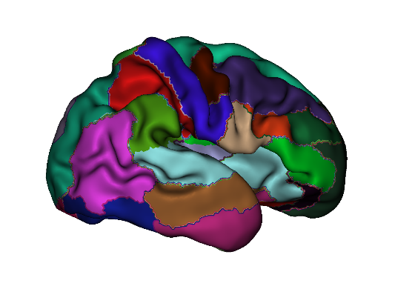
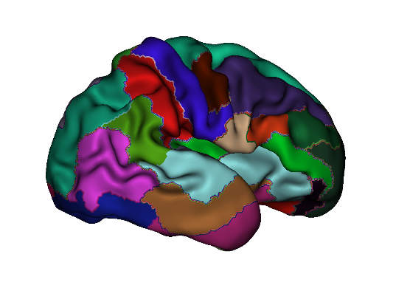
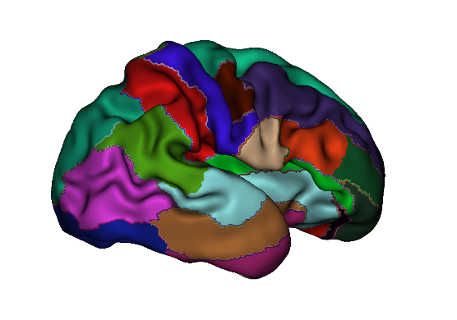
Method – Visual assessment
SESSION 2
44.86 weeks
Lateral view
SESSION 1
Lateral view
33.29 weeks
tMSM
default MSM
sMSM
aMSM
Notes:
Temporal lobe
Cross lateral fissure
TMSM is way better

Slide 26
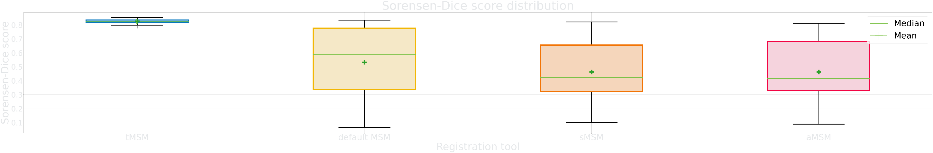
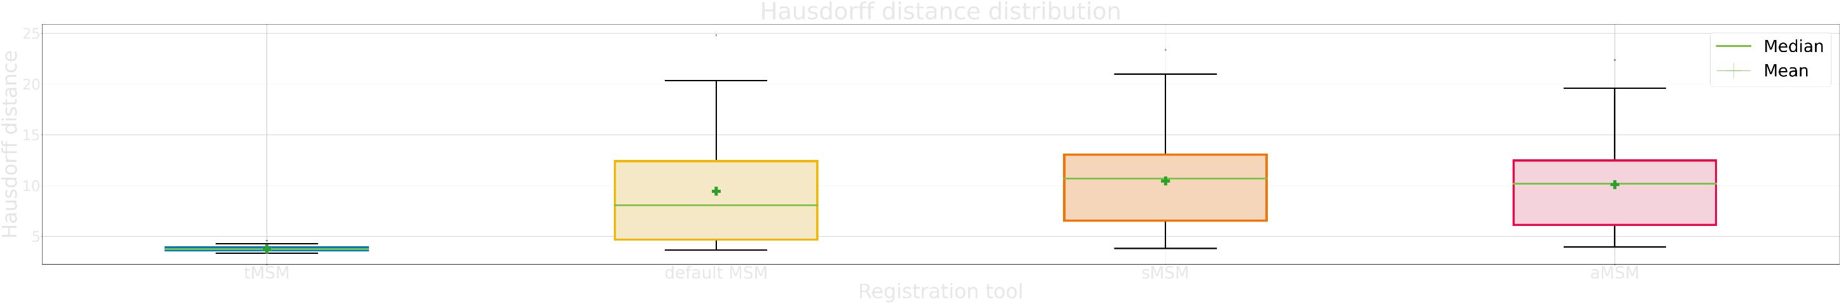
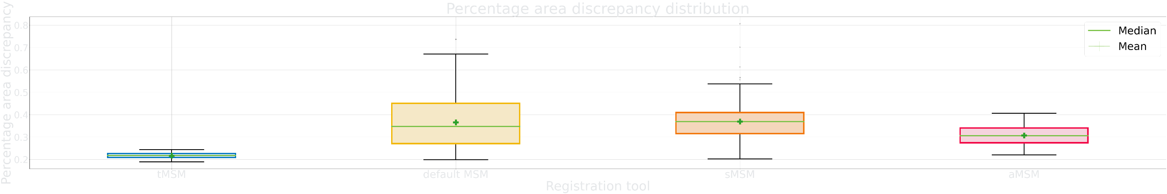
Results – Overall study
Notes:
Three boxplots for three metrics
4 methods on x-axis
Score on y-axis
Mean and median score
tMSM is always better
Other MSM methods vary
Are they different

Slide 27
Results – Overall study
METRIC | sMSM + aMSM + default MSM stat | All methods stat
Sørensen-Dice score | 27.2 | 196
Hausdorff distance | 23.4 | 194
Percentage area discrepancy | 29.6 | 188
Table 2 Friedman test results for methods benchmark, default MSM, sMSM and aMSM and metrics Sørensen-Dice score, Hausdorff distance and Percentage area discrepancy.:
Notes:
See here data do not follow a normal distribution
Use Friedman non parametric test and see
5.99 2 df
7.88 3 df
Three intra-subject matching method are significatively different with way more than 95% of confidence
Same for four subjects

Slide 28
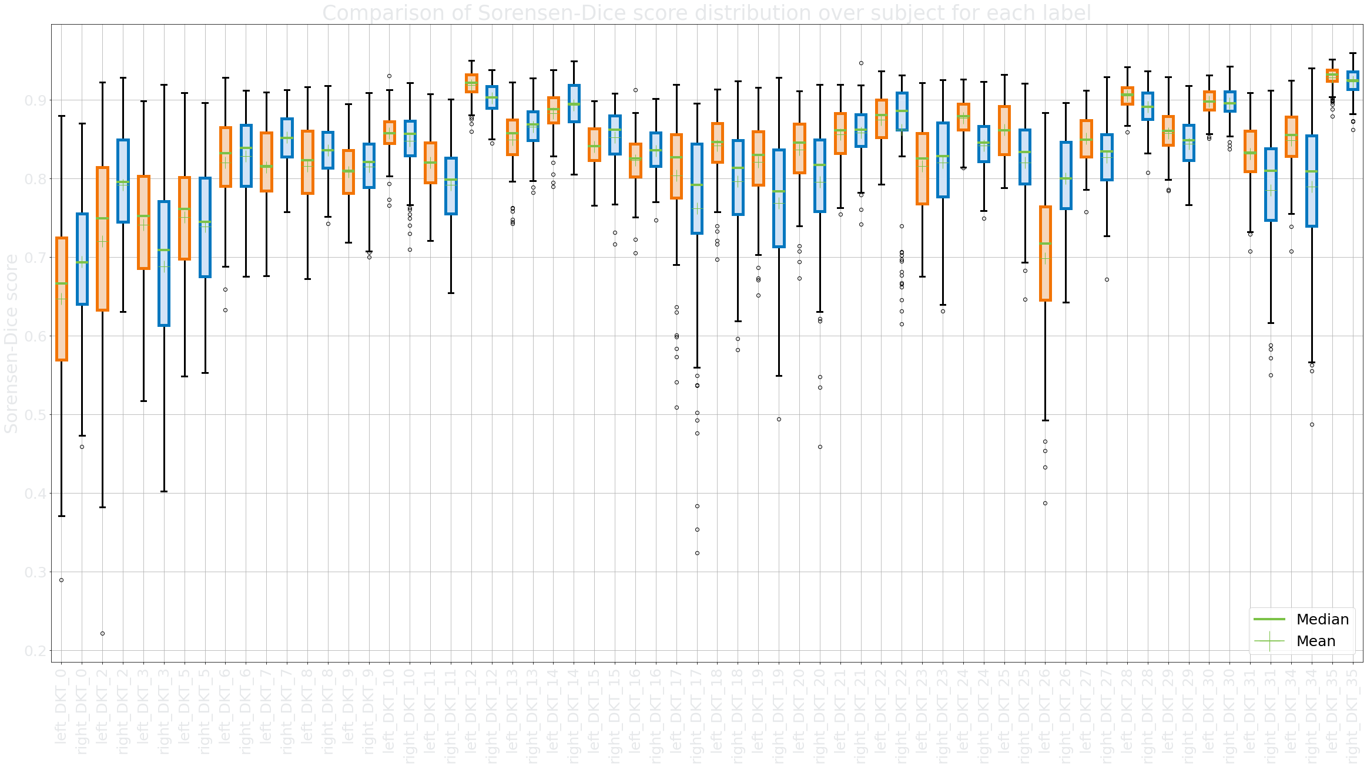
Results – Quantitative assessment per cortical region
LATERAL ORBITOFRONTAL
INSULA
Notes:
Graph we zoom on results
Registration through template
Dice score metric
Per region
See 12, 35V performed very well
0,2,3, 31, 34 not so well
Best method show a variablity in regions
Even for left and right hemisphere

Slide 29
Results – Quantitative assessment per cortical region
LATERAL ORBITOFRONTAL
INSULA
CUNEUS
CAUDAL MIDDLE FRONTAL
CAUDAL INTERIOR CINGULATE
Notes:
Graph we zoom on results
Registration through template
Dice score metric
Per region
See 12, 35V performed very well
0,2,3, 31, 34 not so well
Best method show a variablity in regions
Even for left and right hemisphere

Slide 30
DISCUSSION

Slide 31
Discussion
Age of subject
Highest vs lowest time difference
Notes:
Age of subject, max diff was 8 weeks in Garcia and al

Slide 32
Discussion
Age of subject
Highest vs lowest time difference
Younger vs older subjects with same time difference
Notes:
Maybe our subjects were too young

Slide 33
Discussion
Age of subject
Rotation
Notes:
Still important to take into account intra-subject variability
tMSM better but we want direct MSM methods to be better
Improve many ways
Help MSM having brains in same orientation

Slide 34
Discussion
Age of subject
Rotation
Reversed MSM
Notes:
Reversed it
Allow not to resample

Slide 35
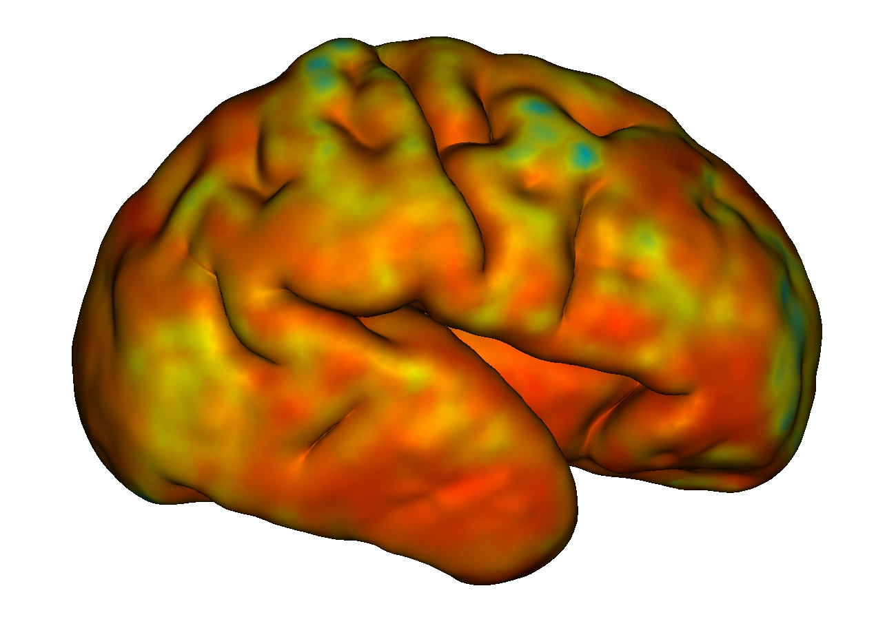
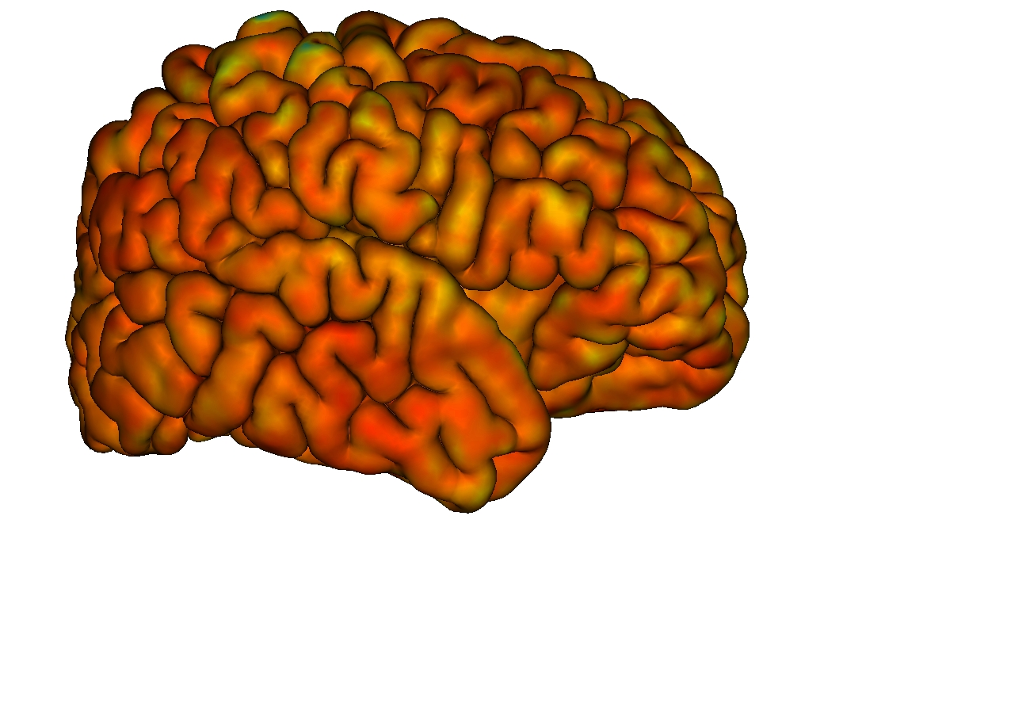
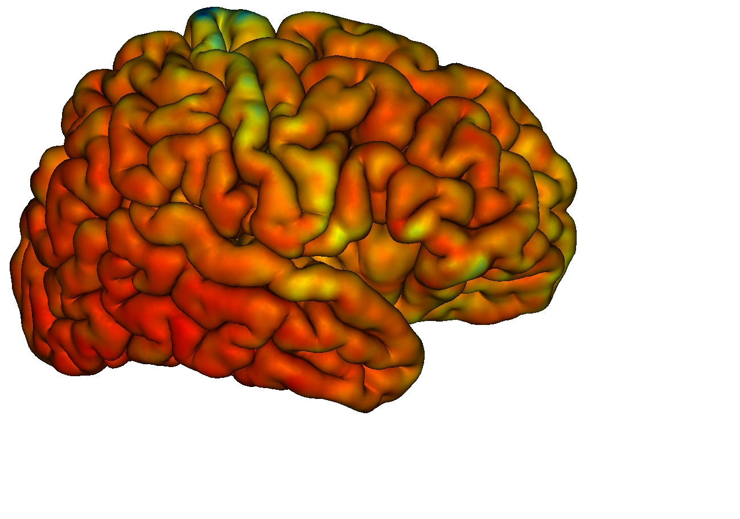
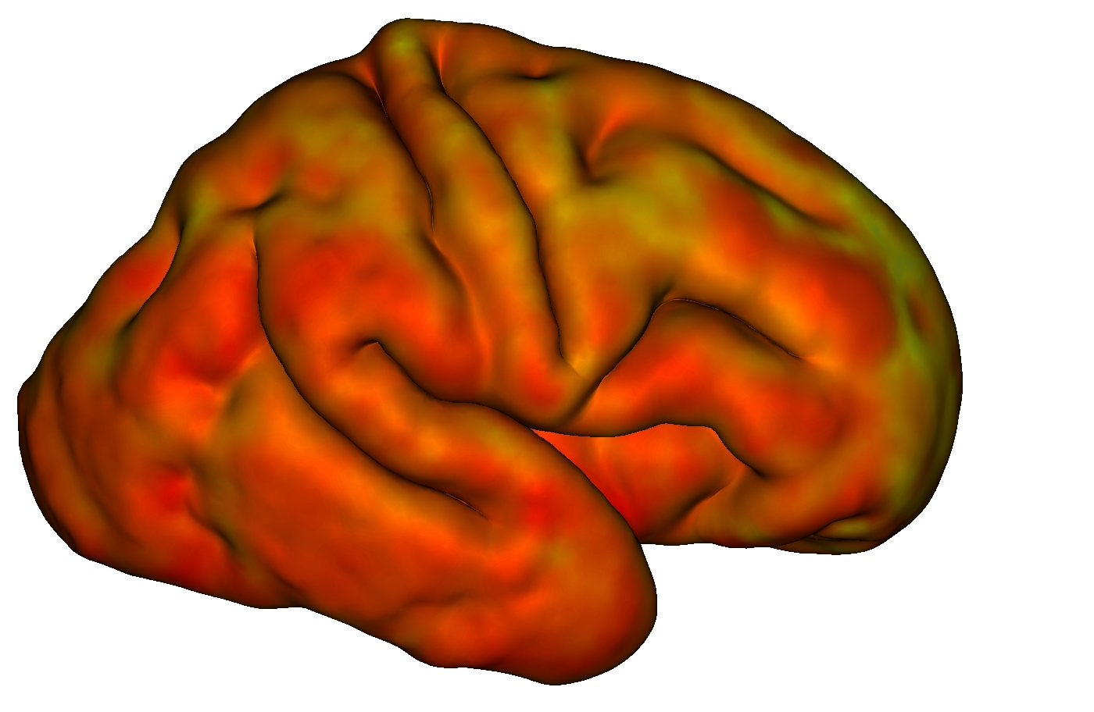
Discussion
SESSION 1
Lateral view
SESSION 2
Lateral view
Age of subject
Rotation
Reversed MSM
Myelin map
29.86 weeks
38.43 weeks
29.86 weeks
41 weeks
Notes:
Use another data like myelin map
Or MSM allows to use many data

Slide 36
Discussion
Age of subject
Rotation
Reversed MSM
Myelin map
Midthickness
Notes:
Use midthickness instead of inner surface
Midthickness is midway between outter and inner surface and would be supposed to give less variance in results

Slide 37
CONCLUSION

Slide 38
Conclusion
Problematic: Find an efficient parcellation scheme for pre-term infants brains

Slide 39
Conclusion
Problematic: Find an efficient parcellation scheme for pre-term infants brains
MSM registration tool

Slide 40
Conclusion
Problematic: Find an efficient parcellation scheme for pre-term infants brains
MSM registration tool
sMSM and aMSM

Slide 41
Conclusion
Problematic: Find an efficient parcellation scheme for pre-term infants brains
MSM registration tool
sMSM and aMSM
tMSM works best

Slide 42
Conclusion
Problematic: Find an efficient parcellation scheme for pre-term infants brains
MSM registration tool
sMSM and aMSM
tMSM works best
Intra-subject matching

Slide 43
Conclusion
Problematic: Find an efficient parcellation scheme for pre-term infants brains
MSM registration tool
sMSM and aMSM
tMSM works best
Intra-subject matching
Further improvment…

Slide 44
Conclusion
Problematic: Find an efficient parcellation scheme for pre-term infants brains
MSM registration tool
sMSM and aMSM
tMSM works best
Intra-subject matching
Further improvment…
Developmental studies

Slide 45
Thank you for your attention !
Notes:
Any questions :
Why both visual and micro stimulation for letter task ?
Why is it a BMI ?
Will you say it is a closed loop experiment ? Brain machine interface ?

Slide 46
Bibliography
[1] Jessica Dubois et al., 2020, MRI of the Neonatal Brain: A Review of Methodological Challenges and Neuroscientific Advances, Journal of Magnetic Resonance Imaging
[2] Chris L. Adamson et al., 2020, Parcellation of the neonatal cortex using Surface-based Melbourne children’s Regional infant Brain atlases (M-cRiB-S), Nature|Scientific reports
[3] Emer. J. Hugues et al., 2017, A dedicated neonatal brain imaging system, Magnetic Resonance in Medicine
[4] Antonios Makropoulos et al., 2018, The developing human connectome project: A minimal pro-
cessing pipeline for neonatal cortical surface reconstruction, NeuroImage
[5] Emma C. Robinson et al., 2019, Multimodal Surface Matching with Higher-Order Smoothness
Constraints, Neuroimage
[6] Kara E. Garcia et al., 2018, Dynamic patterns of cortical expansion during folding of the preterm human brain, Proceedings of the National Academy of Sciences

Slide 47
Conclusion
Problematic: Find an efficient parcellation scheme for pre-term infants brains
MSM registration tool
sMSM and aMSM
tMSM works best
Intra-subject matching
Further improvment…
Developmental studies

